Slide 1

PLAT REFRESHER
The Platting Process in Arlington, Texas
Including Common Questions and Concerns from the Development Community
Richard G. Gertson
Assistant Director of Planning & Development Services

Slide 2

TOPICS TO BE DISCUSSED
Overview of the platting process
What happens during the shot-clock
Getting to “Approved with Conditions”
How and when should I request an extension?
Implications of the 15-day shot-clock
Does having a vested project help?

Slide 3
OVERVIEW OF THE ARLINGTON PLAT PROCESS
30-day Shot Clock
1. PLAT
Pre-Application Meeting
2.
Application Submittal
3.
Completeness Check
4.
Staff Comments In Plat Agenda
5.
P&Z Action
Approve
Approve with Conditions
Approve 30-day Extension
Disapproved
7. New Application
15-day Shot Clock
P&Z Action
Staff Comments
in Plat Agenda
6.
Applicant Response
Approve
Approve with Conditions
Denied

Slide 4
Pursuant to HB3167, the Planning Commission must approve, approve with conditions, or disapprove all plats - preliminary, final, and replats - as well as any site plans or engineering plans associated with those plats.
GETTING TO “APPROVED WITH CONDITIONS”
 Amending plats and minor plats may be approved administratively if there are no conditions or deficiencies.
 Minor. Unplatted; four or fewer lots
 Amending. Review purposes 10 and 11
 Conveyance plats
 For subdividing only
 Parcels are not “developable”
1

Slide 5
Approval: The Plat meets all the requirements of the Unified Development Code, applicable statues, form for recording, and other rules and regulations of the City.
Approval with Conditions: The Plat has deficiencies in substance or form that the City, in its sole discretion, determines that it can be fully corrected or revised without requiring additional review for compliance, without necessitating additional comments for revision, or without substantive modifications to previously reviewed plat-related plans.
Disapproval: The Plat does not meet requirements of the Unified Development Code, applicable statues, form for recording, or other rules and regulations of the City.
Denial: The Plat has previously been disapproved, and the 212.0093 response fails to correct the deficiencies enumerated in the City’s Written Statement of Reasons for disapproval.
GETTING TO “APPROVED WITH CONDITIONS”
2

Slide 6
Effect of Approved with Conditions
 The plat is “off the clock.”
 Applicants are not required to provide a 212.0093 response.
 AWC is an order of the Planning Commission.
 A plat that is AWC is not approved until the City determines that the plat has been corrected or revised to adequately address each and every condition in the Written Statement of Reasons for Conditional Approval.
 Until then, the City shall not accept any submittal pertaining to the development of the property to be platted, including but not limited to a site plan, public infrastructure plans or a final plat. Nor shall the City issue, grant, or release any permit, approval, or work of any kind that would authorize early site work such as tree removal or grading.
GETTING TO “APPROVED WITH CONDITIONS”
3

Slide 7
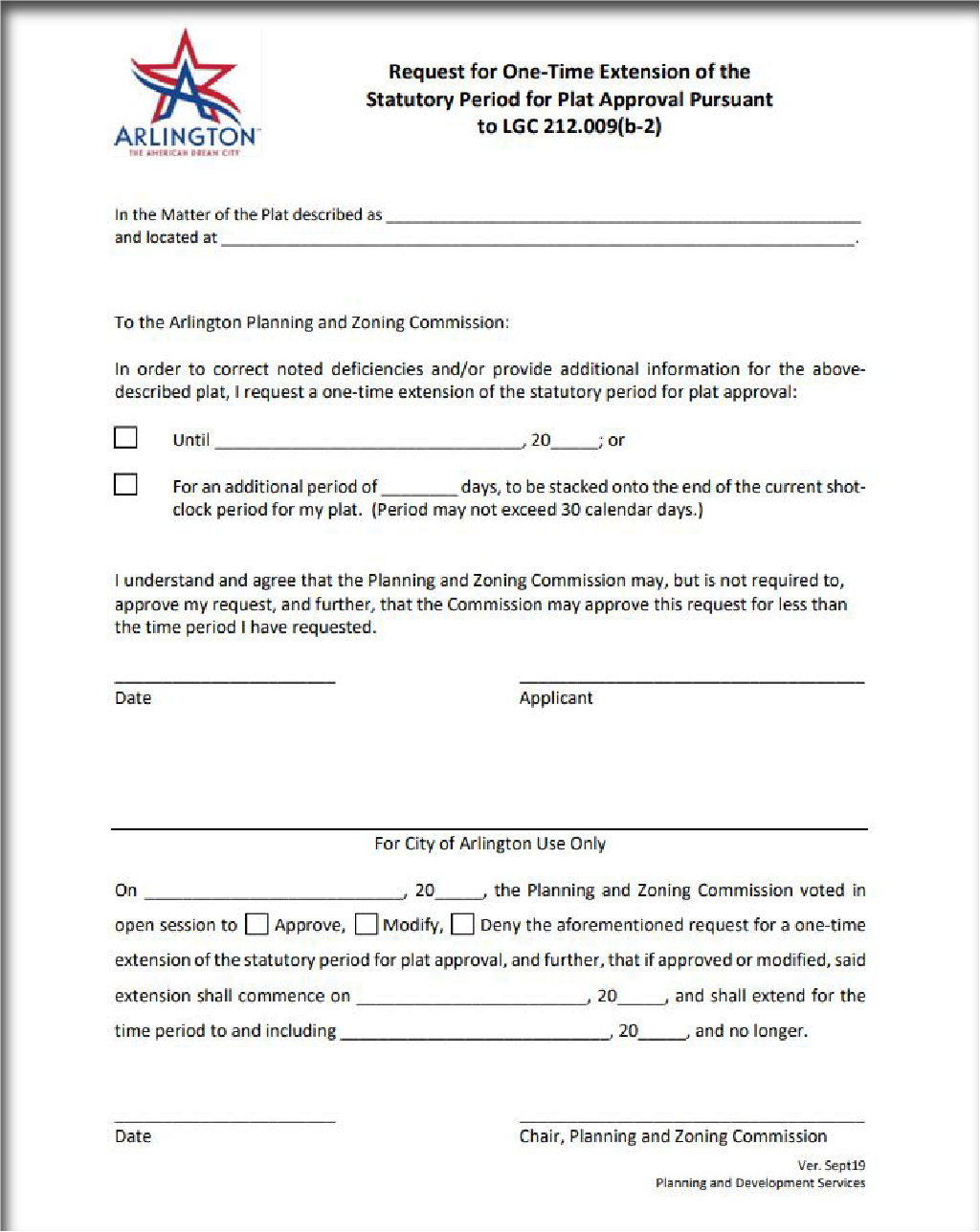
The applicant may request, in writing, a one-time extension of the 30-day shot-clock not to exceed an additional 30 days.
 Applicants have more time to address plat deficiencies.
The Planning Commission may approve, modify, or deny, the shot-clock extension. NOTE: The Planning Commission calendar will not allow for granting a full 30-day extension. Unless the Planning Commission directs otherwise, the extension will be granted for the longest period possible, but in no case longer than 28 days.
Approval of a one-time shot-clock extension does NOT alter the Shot-Clock Calendar.
Download the shot-clock extension request form. Fill it out and email to the case manager no later than 24 hours prior to the Planning Commission meeting.
HOW AND WHEN TO REQUEST AN EXTENSION

Slide 8
IMPLICATIONS OF THE 15 DAY SHOT-CLOCK
 The City cannot impose a deadline for resubmittal.
 Consult the Plat Calendar for the submittal window.
 It’s imperative that applicants fully address the Written Statement of Reasons for Disapproval. (212.0093)

Slide 9
The new procedures apply to all plats filed after September 1, 2019.
 Vesting is available for an active project that filed a complete application prior to that date, in which case the plat shall be processed according to the rules in effect at the time the project vested.
 Timing for submitting site plans and PI
 Landscaping amendments
 Regardless, all plats must comply with completeness requirements, the latest standards for infrastructure, and plat-related fees.
 Applicants must request a vesting determination.
 Applicants with vested projects may take advantage of new rules or shot-clock procedures pursuant to LGC Section 245.002(d), file written notification with the Planning Manager on or before the date a new plat is filed.
DOES HAVING
A VESTED PROJECT HELP?

Slide 10

Q&A
PLAT REFRESHER: The Platting Process in Arlington, Texas
Including Common Questions and Concerns from the Development Community
Richard G. Gertson
Assistant Director of Planning & Development Services

