Slide 1
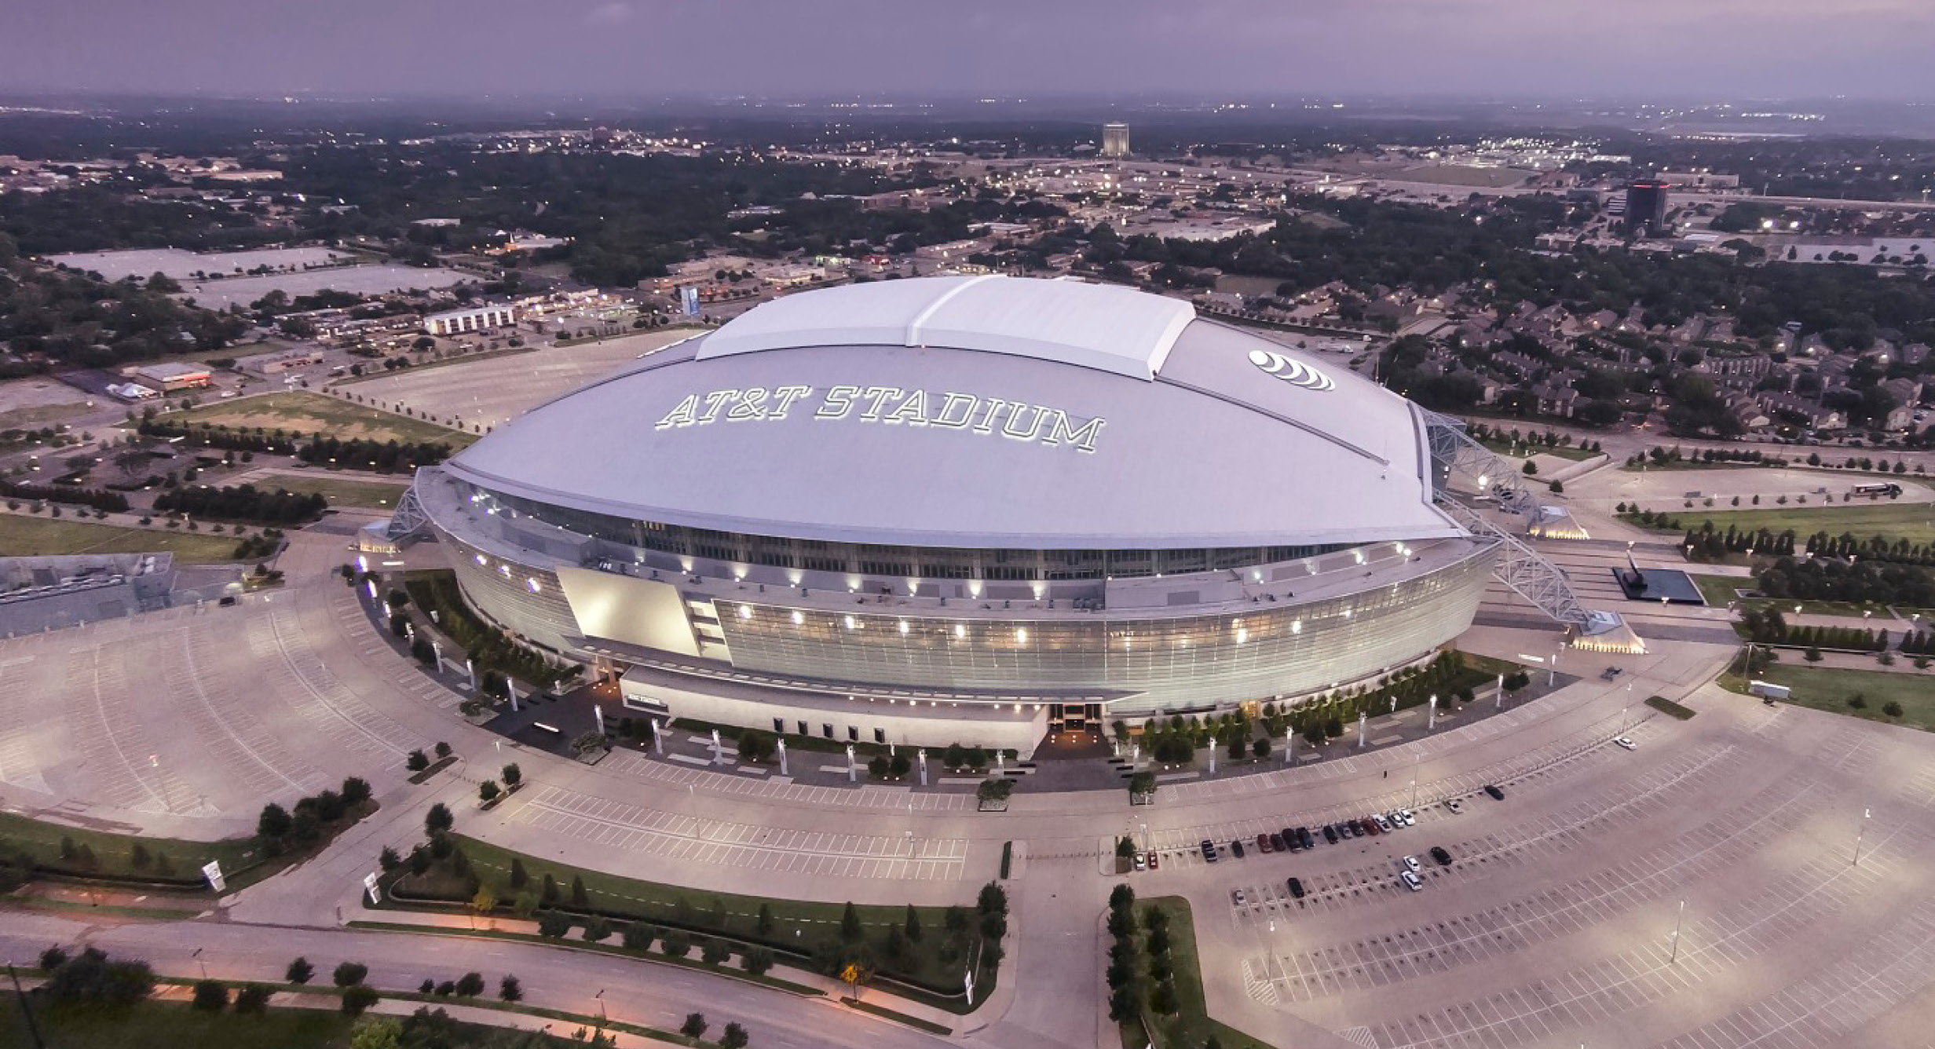

Dallas Cowboys Lease Extension
City Council Work Session
April 21, 2026

Slide 2
Executive Summary
City owns AT&T Stadium and Globe Life Field
Voters approved venue taxes to develop each venue
Team to extend lease and franchise commitments by 15 years
Cost Savings is exceeding expectations - $350M estimated
Savings proposed for improvements - $273M
Team to advance all costs of improvements
Team to invest $750M in stadium complex
No new or increased taxes
Original financing maturity will remain unchanged - 2048

Slide 3
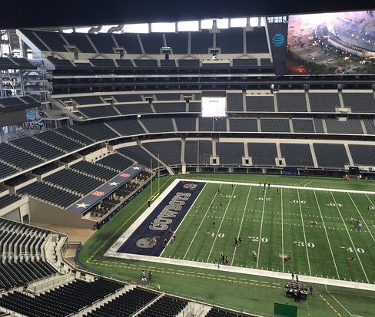
Extension Overview
Opportunity to extend Dallas Cowboys lease at AT&T Stadium for 15 years; current lease ends in 2040, new extension would terminate in 2055
$3M total annual revenue - $2M rent, $500K naming rights, and $500k charitable contributions to continue for additional 15 years instead of dropping to $1M annually under current lease
$32M total new revenue for City during term
Cowboys to advance $273M in complex improvements to be reimbursed by City over time
Reimbursement comes from voter-approved venue taxes that are solely dedicated to the stadiums
No new or increased taxes or extension of current bond maturity date (2048)

Slide 4
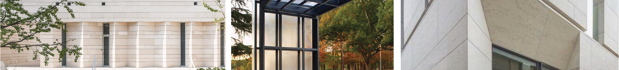
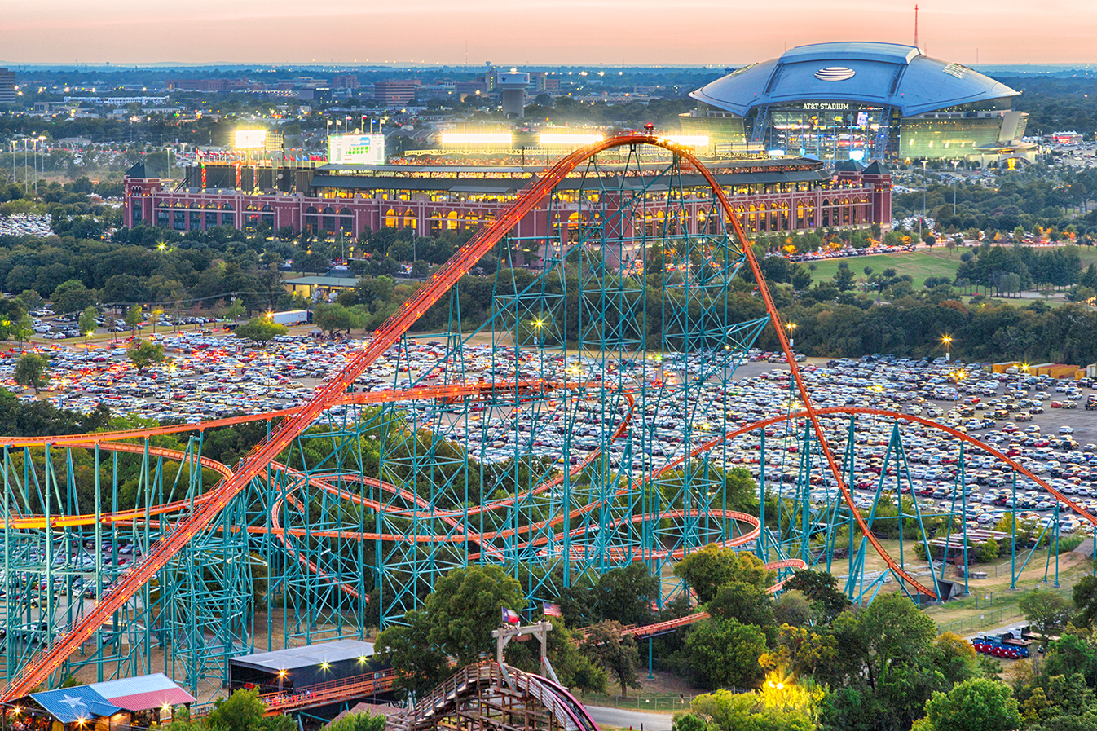
History
65 Years
OF SPORTS, ENTERTAINMENT AND TOURISM HISTORY IN ARLINGTON

Slide 5
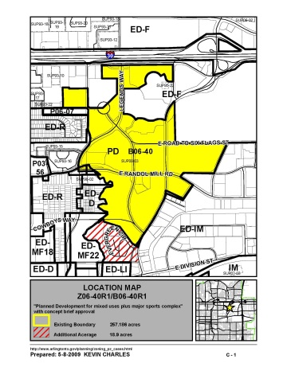
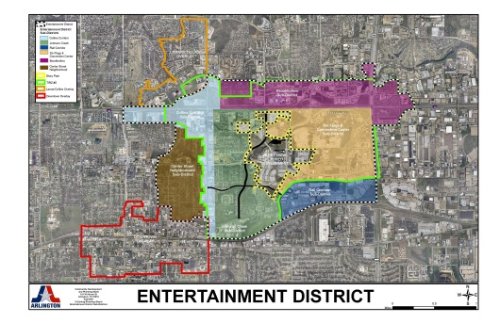
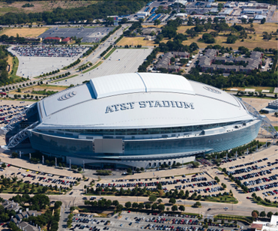
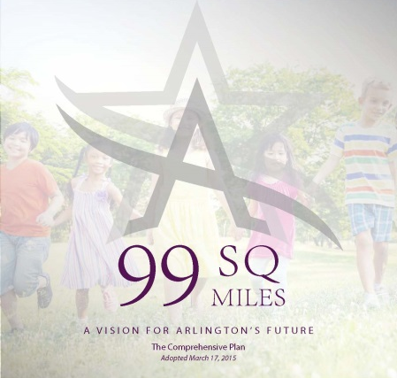
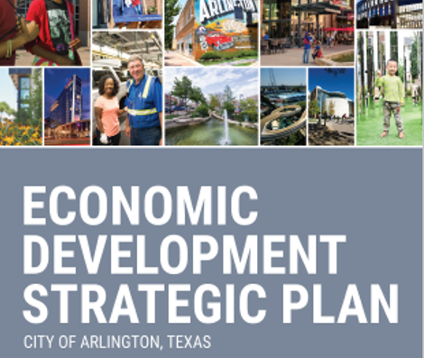
2006
2007
Policy Foundation
2015
2022
“Create amenities and assets that will secure Arlington’s position as a major activity hub in the Metroplex.”

Slide 6
Venue Funding
City
Voter approved sales, hotel, and rental car taxes
53% of sales taxes come from non-residents
Fans
Ticket and Parking Taxes
Economic impact through purchases
Teams
Debt and Equity
Operations and Maintenance

Slide 7
Ballot Language – AT&T Stadium
For AT&T Stadium (2004) under the authority of Chapter 334 of the Texas Local Govt. Code, the ballot language read:
Authorizing the city of Arlington, Texas, to provide for the planning, acquisition, establishment, development, construction and financing of the Dallas Cowboys complex development project within the city and (i) to impose a sales and use tax within the city at a rate of one-half of one percent (0.5%), (ii) to impose a tax at a maximum rate of five percent (5%) on the gross rental receipts from the short-term rental in the city of a motor vehicle, (iii) to impose a tax on the occupancy of a room in a hotel located within the city, at a maximum rate of two percent (2%) of the price paid for such room, (iv) to impose an admissions tax on each ticket sold as admission to an event held at the Dallas Cowboys complex development project, at a maximum rate not to exceed ten percent (10%) of the price of the ticket, and (v) to impose a tax on each parked motor vehicle parking in a parking facility of the Dallas Cowboys complex development project at a maximum rate not to exceed three dollars ($3.00) per vehicle.

Slide 8
Ballot Language – Globe Life Field
For Globe Life Field (2016) the ballot language read:
“Authorizing the City of Arlington to provide for the planning, acquisition, establishment, development, construction and financing of the Texas Rangers complex development project and related infrastructure, within the city of the type described and defined in section 334.001(4)(a) of the local government code as amended (the “act”) and (i) to impose a parking tax, at a rate not to exceed three dollars ($3.00) on each parked motor vehicle parking in a parking facility of the Texas Rangers complex development project, as and to the extent authorized by subchapter g of the act, (ii) to impose an admissions tax on each ticket sold as admission to an event held at the Texas Rangers complex development project, at a rate not to exceed ten percent (10%) of the price of the ticket sold as admission, as and to the extent authorized by subchapter f of the act; (iii) to authorize the use of the existing hotel occupancy tax on the occupancy of a room in a hotel located within the city, at a rate not to exceed two percent (2%) of the price paid for such room and to the extent authorized by subchapter h of the act and if approved the maximum hotel occupancy tax rate imposed from all sources in the city would be 15%; (iv) to authorize the use of the existing sales and use tax within the city at a rate of one-half of one percent (0.5%), as and to the extent authorized by subchapter d of the act; and (v) to authorize the use of the existing motor vehicle short-term rental tax at a maximum rate of five percent (5%) on the gross rental receipts from the short-term rental in the city of a motor vehicle, as and to the extent authorized by subchapter e of the act.”.

Slide 9
Venue Projects
History
2004 Dallas Cowboys Complex Venue Project
Voter Approved
Method of Finance - Venue Taxes Including:
Sales/Hotel/Motor Vehicle Taxes – supported bonds sold in 2005
Ticket/Parking Taxes – supported bonds sold in 2006
Sales/Hotel/Motor Vehicle Tax Bonds – refinanced in 2008, 2009, and 2017
2016 Texas Rangers Complex Venue Project
Voter Approved
Method of Finance - Venue Taxes Including:
Sales/Hotel/Motor Vehicle Taxes – supported bonds sold in 2018 with 2048 maturity
Ticket/Parking Taxes – supported bonds sold in 2020

Slide 10
Venue Tax Fund
Eligible expenses (334.042 of the Venue Statute)
Reimburse or pay the costs of planning, acquiring, establishing, developing, constructing, or renovating one or more approved venue projects in the municipality or county
Pay the principal of, interest on, and other costs relating to bonds or other obligations issued by the municipality or county or to refund bonds, notes, or other obligations, or
Pay the costs of operating or maintaining one or more approved venue projects
Revenues currently exceeding required debt service by approximately $20M per year
Funds not required for debt service have to be used pursuant to 334.042 of the Venue Statute
Chapter 334 does not provide a process or requirement for secondary voter approval to determine what expenses are paid from the Venue Fund

Slide 11
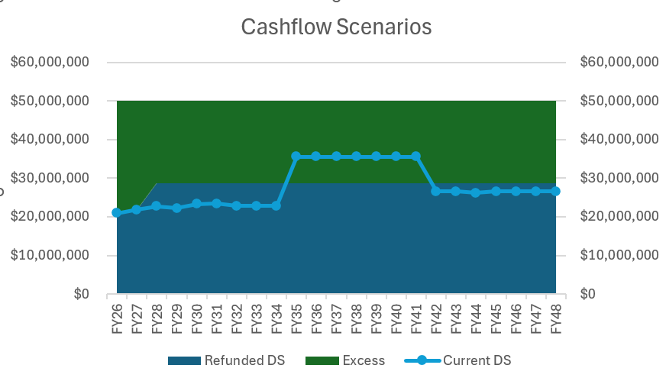
Funding Mechanism
Venue bonds are supported by a voter-approved pledge of sales tax, HOT, and motor vehicle tax
30-year statutory limit
Tax revenue not needed for debt service is used for early bond redemption
2028 would be the next opportunity to refinance to allow tax revenues not required for debt service to be used for operation/maintenance of the venue projects

Slide 12
Visitor
Profile
2024 Compass Longwoods International Travel USA Visitor Profile for Arlington:
16.3 million visitors
$3.1 billion domestic travel market spend
2025 VISA Cardholder data:
53% of spend citywide from non-Arlington residents
47% of spend citywide from Arlington residents

Slide 13
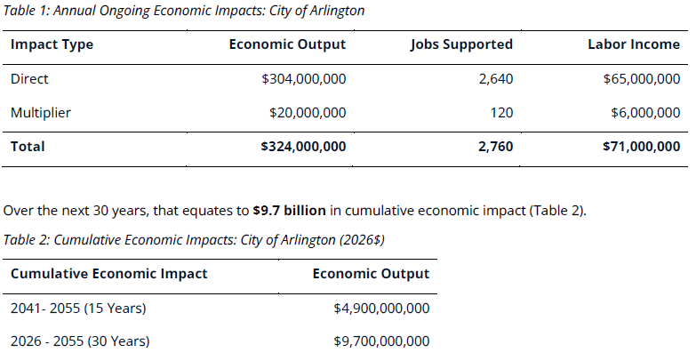
Economic Impact
Source: HR&A Advisors

Slide 14
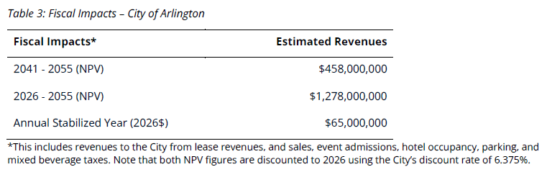
Fiscal Impact
Source: HR&A Advisors

Slide 15
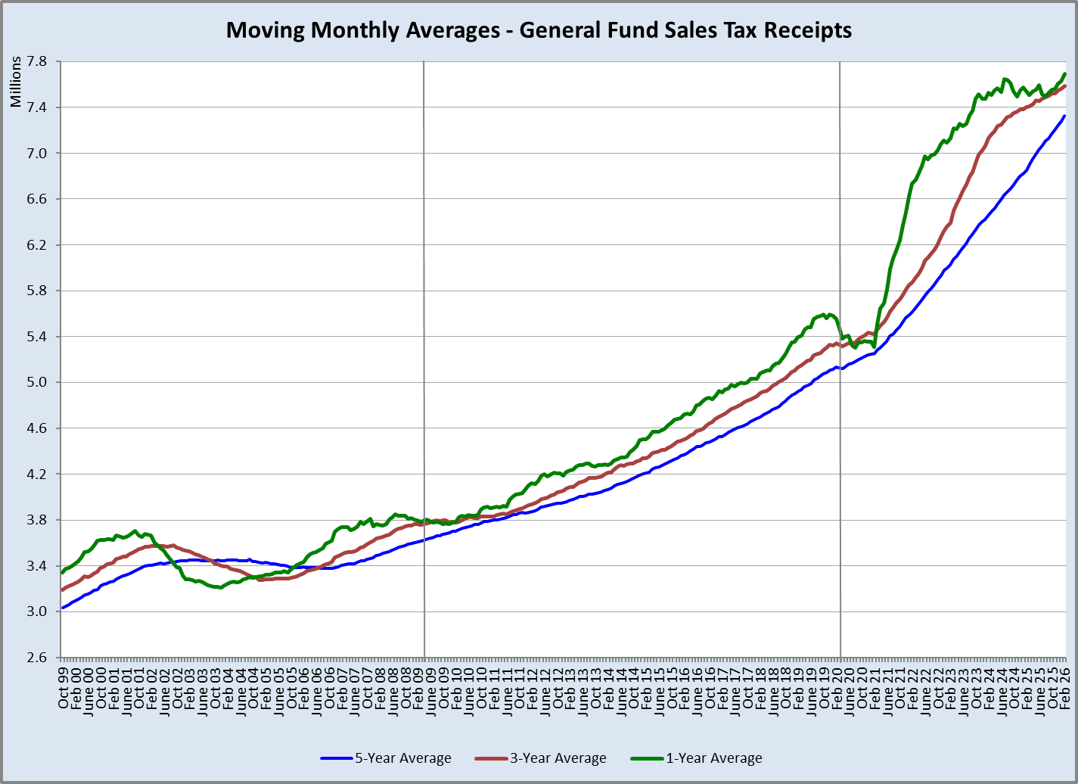
General Fund Sales Tax History

Slide 16
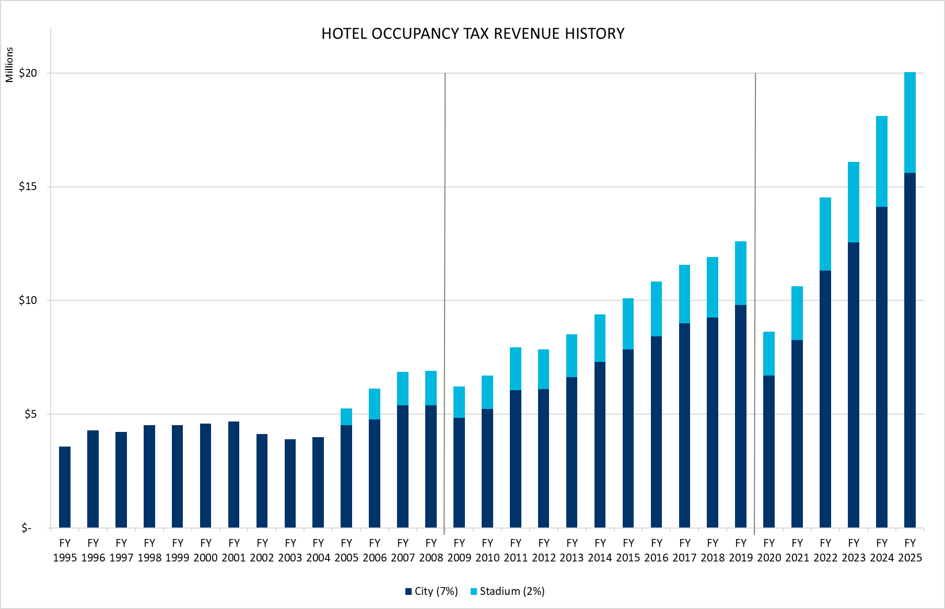
Hotel Occupancy Tax History

Slide 17
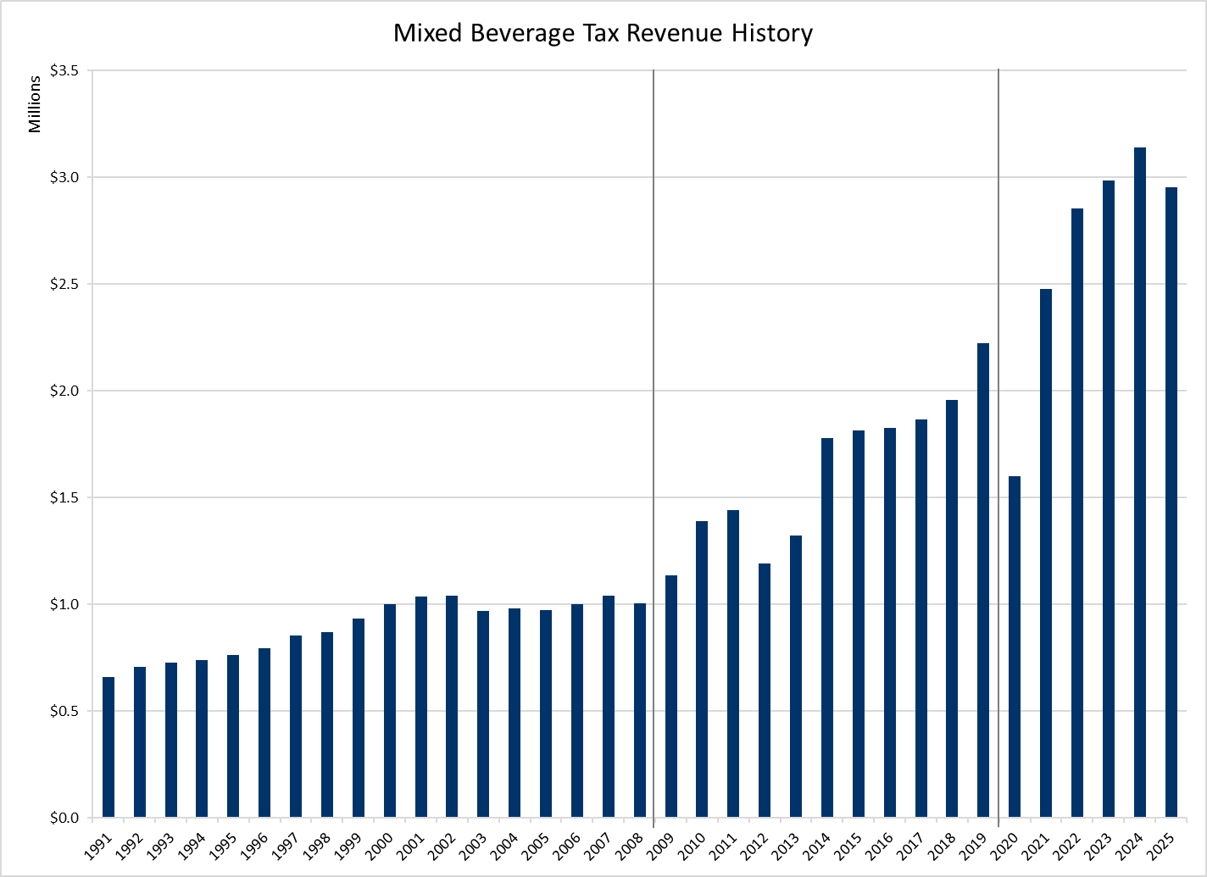
Mixed Beverage Tax History

Slide 18
Ad Valorem Comparison
 | 2004 | 2025 | % Change
Stadium | $177.9M | $747.0M | 320%
City | $20.7B | $60.4B | 192%

Slide 19
Economic Development Supports the Costs of Enhanced Public Services
Service Enhancements Since FY 2009:
Number of Sworn Police Positions Added: 91
Number of Sworn Fire Positions Added: 172
Opened Fire Station 17 (Viridian)
Opened Downtown Library
Opened Two New Recreation Centers
New Lane Miles Constructed: 66
Total Number of Lane Miles Maintained: 3,018

Slide 20
Growth of Capital Improvement Program

Slide 21
Complex Improvements
Elongate useful life of City’s Stadium Complex
Sustain economic impact for the community & fiscal impact for the City
Enhance facility security & public safety infrastructure
Increase vehicular & pedestrian safety and traffic & mobility systems

Slide 22
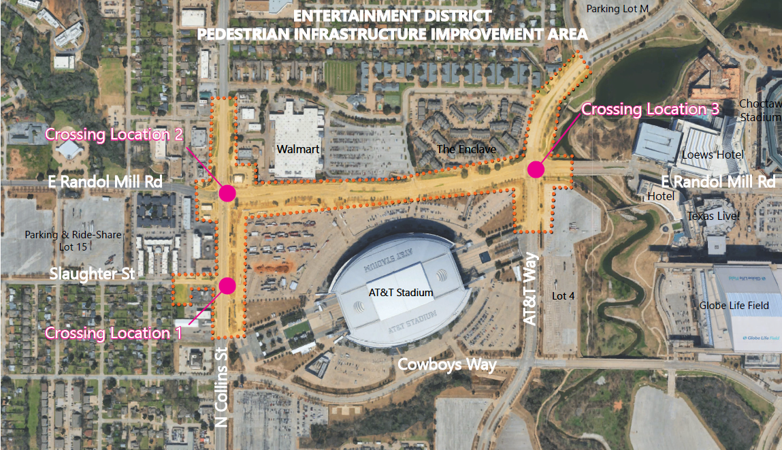
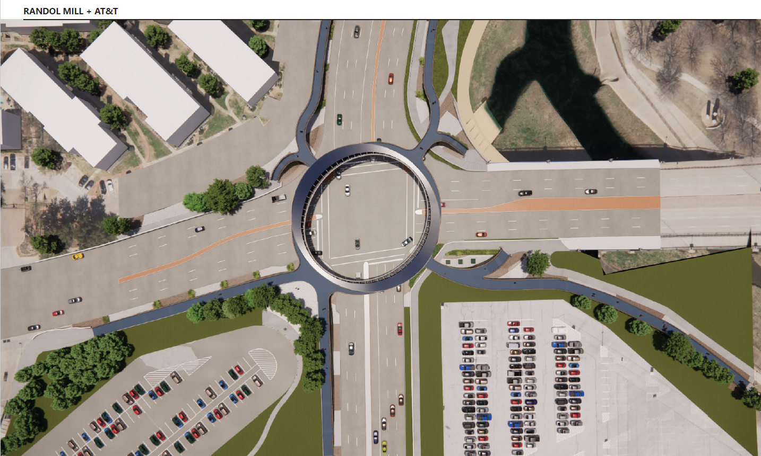
Complex Improvements
SAFETY Act perimeter hardening
Pedestrian/vehicular separation, including bridges
Screening facility
Cameras, detection, access control enhancements
Employee access screening
Additional venue parking, including rideshare
Signage, including digital boards
Kitchen and concession build out
Mechanical, electric and plumbing improvements, including chiller replacement
Plaza improvements, including shade structures and restrooms
Technology improvements for fans and operations
Replacement of certain area finishes
Glass film, safety and energy efficiency

Slide 23
Additional Agreement Terms
Improve Arlington emphasis on TV, radio, web, media guides, and on stadium complex signage
Suite commitment for lease term
Commitment to use good faith efforts to cooperate on economic development efforts, including efforts to assemble strategic tracts of land in the Entertainment District and explore develop on portions of the parking lots
Commitment to use good faith efforts to collaborate on mobility in the Entertainment District
Pursue SAFETY Act Certification

Slide 24
Funding Summary
Team: $750M total commitment over lease term
City: $273M (net present value)
Team would fund all improvements up-front and be paid back by the City over time
$50M in 2028
$20M in 2029 through 2048
Offsets to City Contribution
Early City Payment
Grants
Interest Savings

Slide 25
New Venue Project
Voter approval process
Could levy newly authorized taxes for 30 years from bond issuance, i.e. 2028-2058
Existing authorized project funding ends after 30 years in 2048 without voter approval to extend
Since same voter approved taxes are utilized within the same initial bond maturity, there is not a process or legal requirement for a secondary project election

Slide 26
Next Steps
Today: Council action on Master Agreement Regarding Cowboys Stadium Extension
Lease Amendment, Franchise Amendment, Purchase Option Amendment, Lease Guaranty Amendment, and Charitable Contribution Amendment
Late 2027: Council action on 2018 bond refunding to open lien
Early 2028: Refunding closes and all amendments are executed extending Cowboys commitments

Slide 27
Summary
Team Investment
Team Advances All Funds
City Reimburses Up to $273M NPV from venue taxes that are already approved for collection
City Funding From Existing Venue Tax Fund
No new taxes, same 30 year end to the taxes in 2048
Plan to refinance existing bonds to same 2048 maturity
Funds not required for debt service available for eligible venue expenses
Impact and Rationale
$324M annual impact/$9.7B total impact over 30 years
$458M fiscal impact to City over 15-year extension
Enhanced public safety
Protection of public infrastructure and assets
Sustained economic return
Mitigation of future risks

Slide 28
Discussion

Slide 29
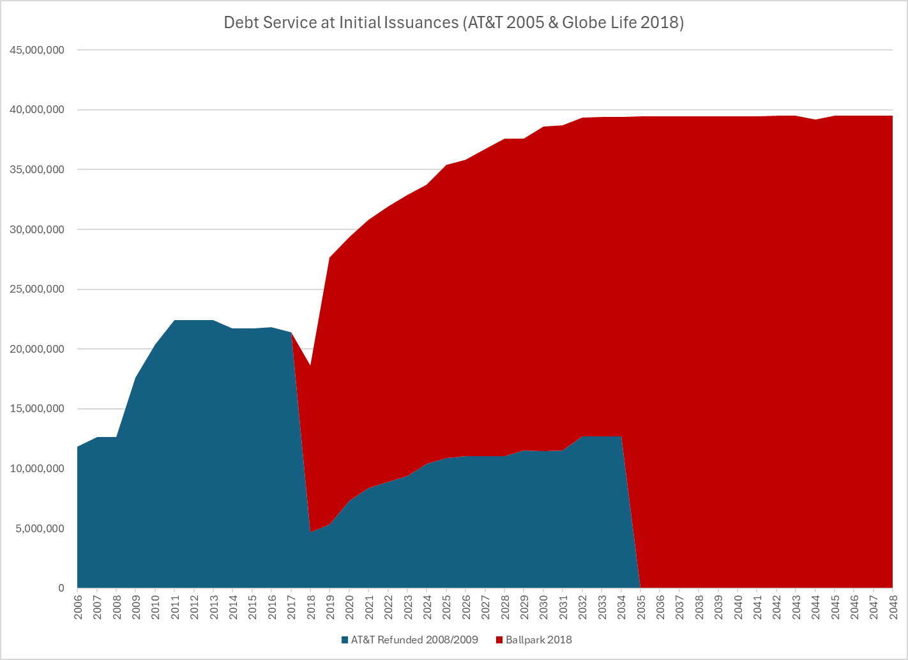
Initial Debt Service Schedule

Slide 30
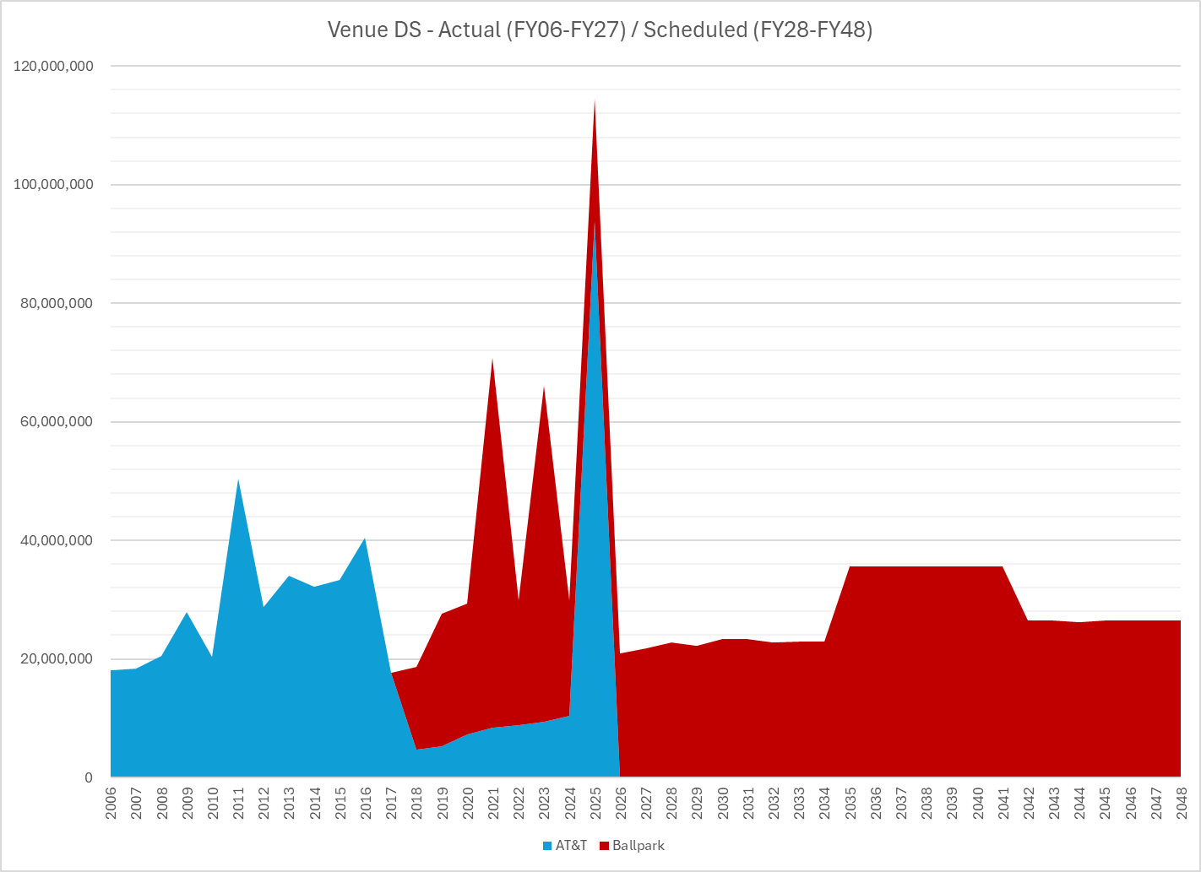
Current Debt Service Schedule

Slide 31
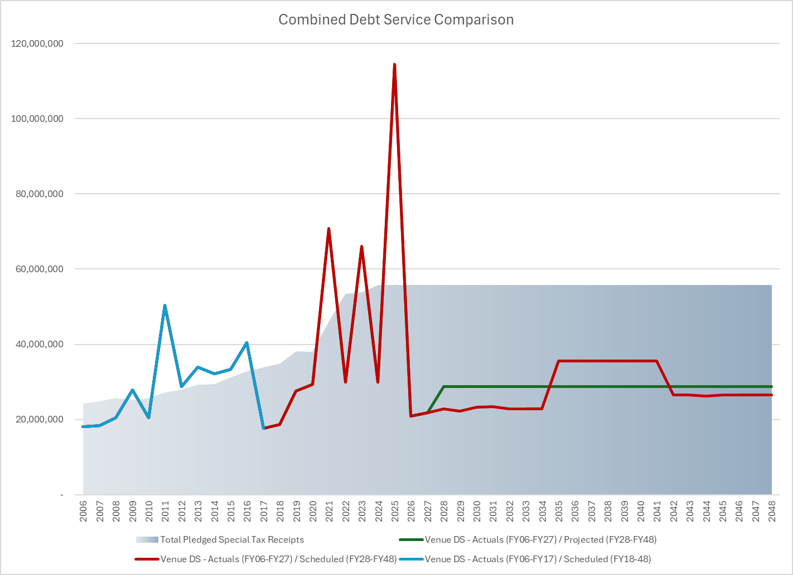
Combined Debt Service Comparison

